Slide 1


Fuel For Tomorrow Innovation Challenge Grand Theme:
Everyone needs to fuel and hydrate to maintain a healthy and active lifestyle. As our day-to-day needs continually evolve and adapt to our ever-changing world – so will desires in the beverages we consume.
For this challenge, we want to hear your unique perspective and ideas to “solve a consumer need” under one of five categories. Think about the category you choose wisely and consider what someone in that situation might truly need or desire in a product from Gatorade.
Think wide with an eye to what may be desirable and feasible in the next 2-5 years. Is your product a new hydrating beverage? Is it even liquid to start? Perhaps it’s in a new format that is transformed by the consumer at the time of consumption? Is it delivered in a bottle, a can or something new? Maybe it is a totally new concept no one has thought of before! YOU take the creative reins and tell us!

Slide 2

Innovation Submission Categories:
G Gurlz
Beverages designed and detailed from a female identifying cohort perspective.
G Active -
Beverages for use in the active moment when your body and mind need the fuel to stay at the top of your game and keep pushing.
G Social -
Beverages for social settings - to stay fueled while enjoying a shared experience with others.
G Life
Beverages to supports a healthy lifestyle each and every day while being mindful of the planet we all share.
G Unchartered -
Beverages that fuel this generation in a way no other brand or product has done before!

Slide 3
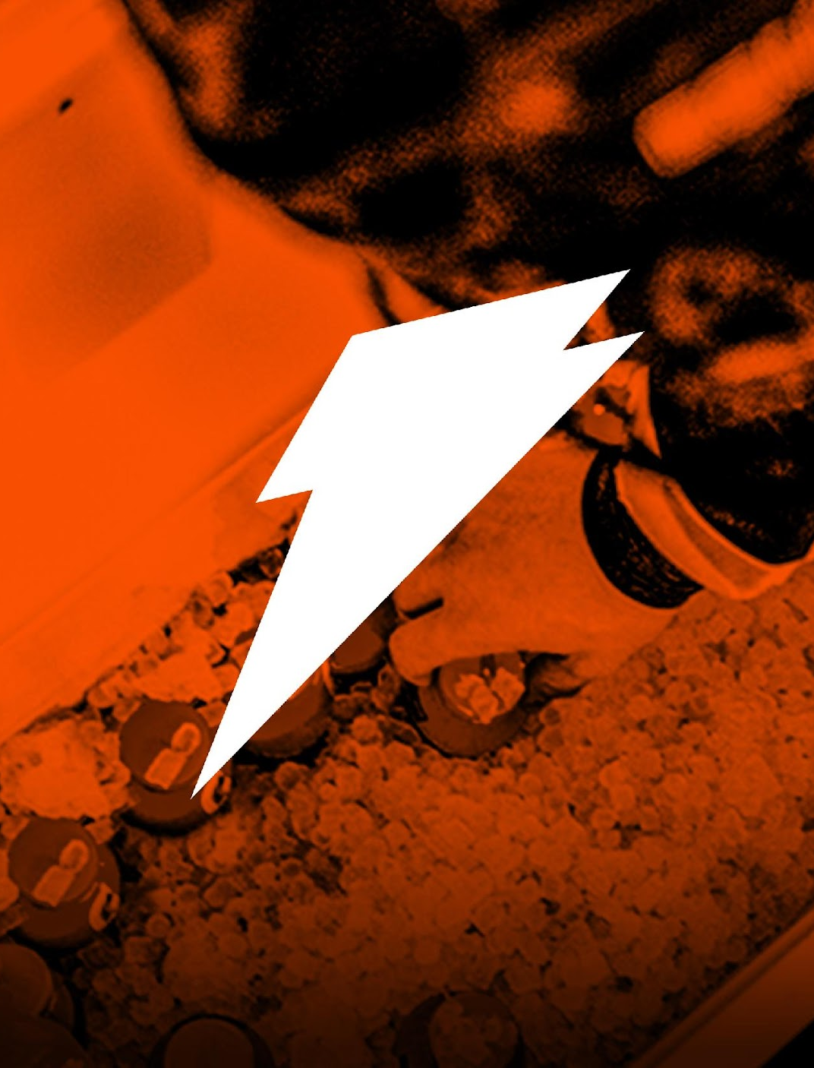
Rules of the court - What is in bounds!
Innovation must be consumable. The innovation must include a beverage or form of a beverage that delivers on core Gatorade pillars - Hydration and refueling of the body).
The innovation should be intended for individuals of the Gen Z generation (currently 12 - 25 years old).
We recommend supporting your submission with visuals (images, drawings, collages, pictures of mockups, etc.) and to keep your innovation descriptions clear and to the point in a meaningful and catchy presentation style! Wow us!
Innovations should NOT include, focus or have intended use within the alcohol category, the CBD category, or result in non-beverage-based solutions (ie. Energy Bars, Gums, Gummies and like products.)
While the challenge is focused on future products – keep in mind the realm of physics, economics, feasibility and plain old common sense! While a “drone made of gold that flies behind you while running providing uniquely flavored ultra hydrating dragonfruit based beverage on demand” would be awesome – that might be a bit far fetched for this competition.

Slide 4
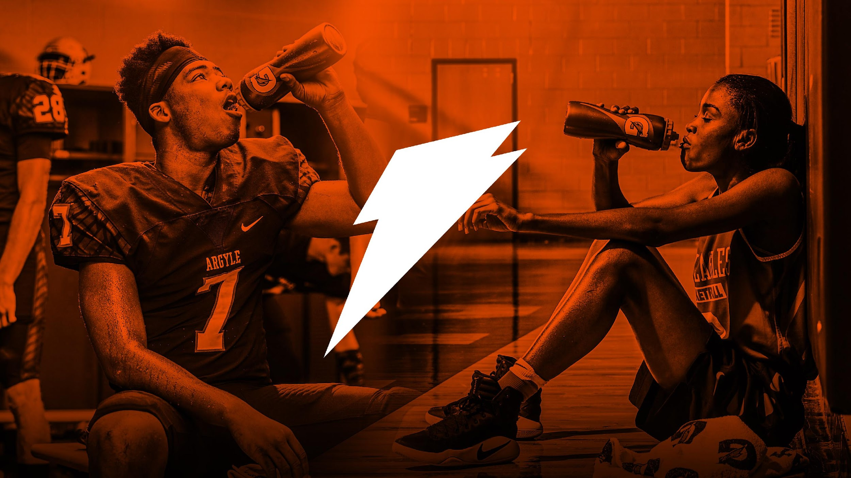
Information to consider regarding the Beverage / Consumable you are creating:
What is the beverage you are formulating?
While consumers might be first attracted by the packaging or format, the actual beverage (what you consume) will be the key driver to buy again.
When thinking about your beverage formulation, consider:
Initial Format (Liquid, Powder, Tablet, ????)
Base ingredients (ex. water, coconut water, watermelon juice, etc.)
Flavor
Color
Texture
Nutrition Facts
Sweet vs Salty vs Sour vs Umami
Sweet ingredients (sugar, sweetener, juice, etc.)
???????

Slide 5
Information to consider regarding the packaging or method of delivery for the beverage:
Consumption of a product requires delivering it to consumers in a relevant manner which meet their needs.
How should your product be packaged to best fit the occasion and convey how great the product is?
When thinking about the package or delivery method, consider things such as:
Material (plastic, aluminum, cardboard, etc…)
Shape, proportion and form - Think abou thow it communicates and supports the innovation benefits
Color, texture, finish
Branding, label, graphics, etc…
Functionality - does it provide a new way to consume or improve the experience in a unique way?

Slide 6
UTILIZE THE FOLLOWING SLIDES FOR THE INNOVATION SUBMISSION

